Slide 1
Short-Run Costs and Output Decisions
Dr. Jalandhar Pradhan
Reference: Karl E. Case, Ray C. Fair and Sharon M. Oster: Principles of Economics, Pearson Publisher

Slide 2
SHORT-RUN COSTS AND OUTPUT DECISIONS
You have seen that firms in perfectly competitive industries make three specific decisions.
DECISIONS | are based on |  | INFORMATION
The quantity of output to supply |  |  | 1. The price of output
How to produce that output (which technique to use) |  |  | Techniques of production available*
The quantity of each input to demand |  |  | 3. The price of inputs*
 |  | *Determines production costs
FIGURE 1 Decisions Facing Firms
<number> of 31

Slide 3
COSTS IN THE SHORT RUN
fixed cost Any cost that does not depend on the firm’s level of output. These costs are incurred even if the firm is producing
nothing. There are no fixed costs in the long run.
variable cost A cost that depends on the level of production chosen.
total cost (TC) Fixed costs plus variable costs.
<number> of 31

Slide 4
COSTS IN THE SHORT RUN
FIXED COSTS
Total Fixed Cost (TFC)
total fixed costs (TFC) or overhead The total of all costs that do not change with output, even if output is zero.
TABLE 1 Short-Run Fixed Cost (Total and Average) of a Hypothetical Firm
(1) Q | (2) TFC | (3) AFC (TFC/Q)
0 1 2 3 4 5 | $1,000 $1,000 $1,000 $1,000 $1,000 $1,000 | $ − 1,000 500 333 250 200
Firms have no control over fixed costs in the short run. For this reason, fixed costs are sometimes called sunk costs.
<number> of 31

Slide 5
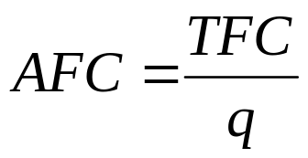
COSTS IN THE SHORT RUN
sunk costs Another name for fixed costs in the short run because firms have no choice but to pay them.
Average Fixed Cost (AFC)
average fixed cost (AFC) Total fixed cost divided by the number of units of output; a
per-unit measure of fixed costs.
<number> of 31

Slide 6
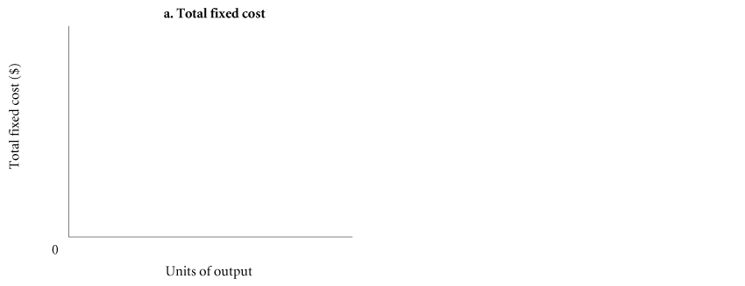

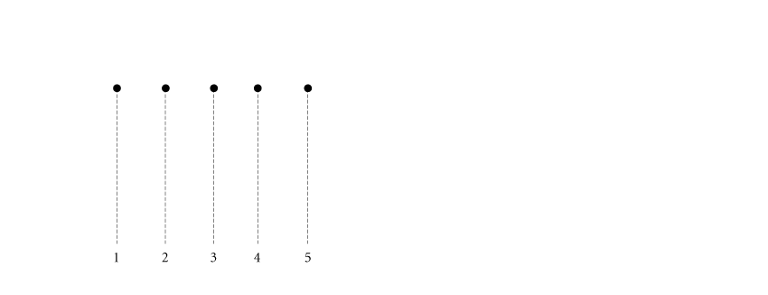
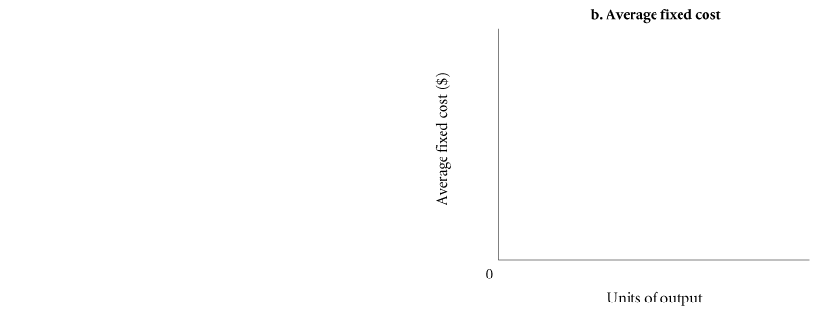
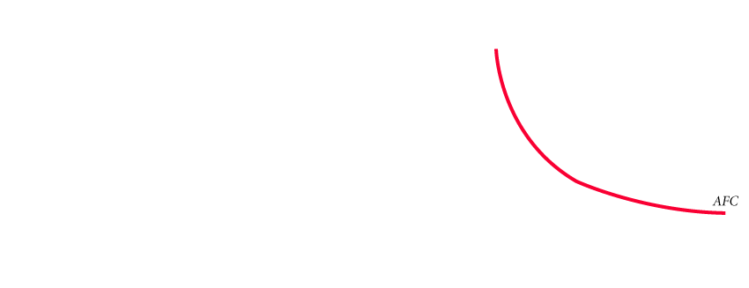
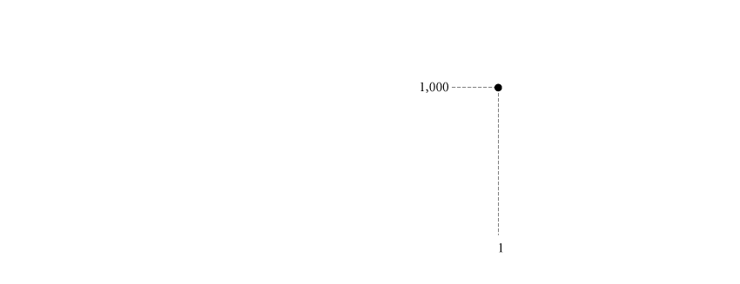
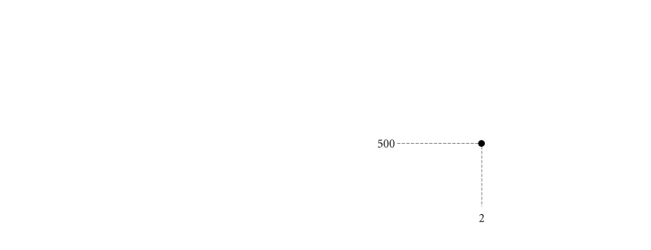
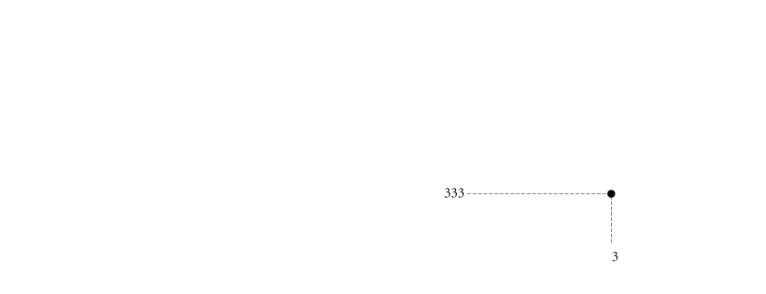
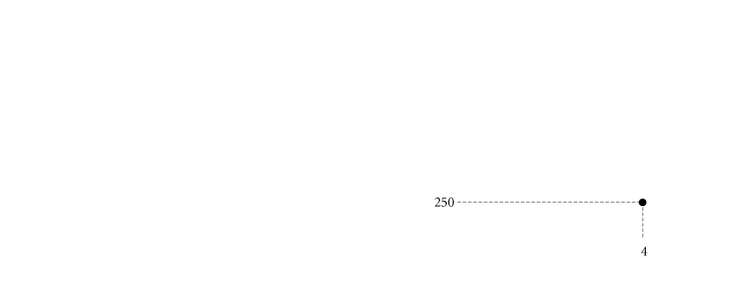
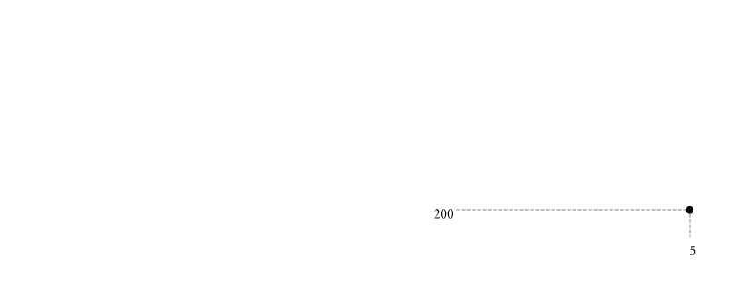
COSTS IN THE SHORT RUN
FIGURE 8.2 Short-Run Fixed Cost (Total and Average) of a Hypothetical Firm
spreading overhead The process of dividing total fixed costs by more units of output. Average fixed cost declines as quantity rises.
<number> of 31

Slide 7
COSTS IN THE SHORT RUN
VARIABLE COSTS
Total Variable Cost (TVC)
total variable cost (TVC) The total of all costs that vary with output in the short run.
total variable cost curve A graph that shows the relationship between total variable cost and the level of a firm’s output.
<number> of 31

Slide 8
COSTS IN THE SHORT RUN
TABLE 2 Derivation of Total Variable Cost Schedule from Technology and Factor Prices
PRODUCE
USING
TECHNIQUE
UNITS OF INPUT REQUIRED
(PRODUCTION FUNCTION)
K L
TOTAL VARIABLE COST ASSUMING P_{K} = $2, P_{L} = $1
TVC = (K x P_{K}) + (L x P_{L})
1 Unit of
output
A
B
4
2
4
6
(4 x $2) + (4 x $1) = $12
(2 x $2) + (6 x $1) = $10
2 Units of
output
A
B
7
4
6
10
(7 x $2) + (6 x $1) = $20
(4 x $2) + (10 x $1) = $18
3 Units of
output
A
B
9
6
6
14
(9 x $2) + (6 x $1) = $24
(6 x $2) + (14 x $1) = $26
<number> of 31

Slide 9
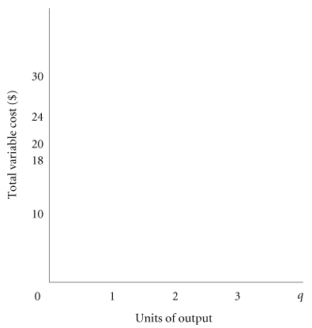
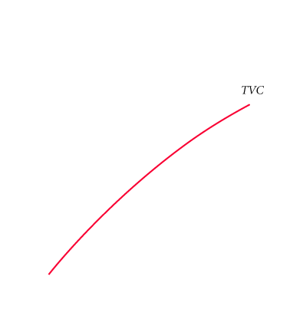
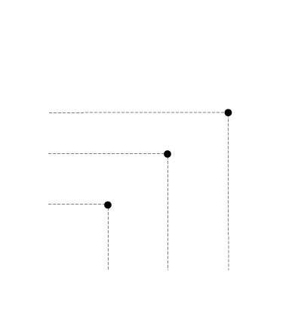
COSTS IN THE SHORT RUN
FIGURE 3 Total Variable Cost Curve
The total variable cost curve embodies information about both factor, or input, prices and technology. It shows the cost of production using the best available technique at each output level given current factor prices.
<number> of 31

Slide 10
COSTS IN THE SHORT RUN
Marginal Cost (MC)
marginal cost (MC) The increase in total cost that results from producing one more unit of output. Marginal costs reflect changes in variable costs.
<number> of 31

Slide 11
COSTS IN THE SHORT RUN
TABLE 8.3 Derivation of Marginal Cost from Total Variable Cost
UNITS OF OUTPUT | TOTAL VARIABLE COSTS ($) | MARGINAL COSTS ($)
0 1 2 3 | 0 10 18 24 | 0 10 8 6
Although the easiest way to derive marginal cost is to look at total variable cost and subtract, do not lose sight of the fact that when a firm increases its output level, it hires or demands more inputs. Marginal cost measures the additional cost of inputs required to produce each successive unit of output.
<number> of 31

Slide 12
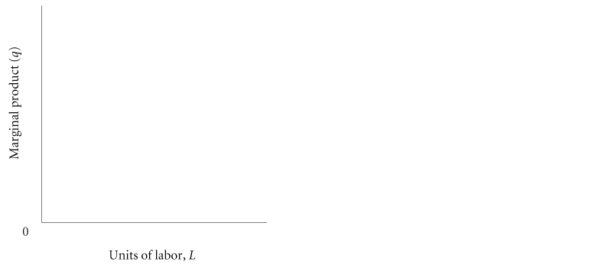
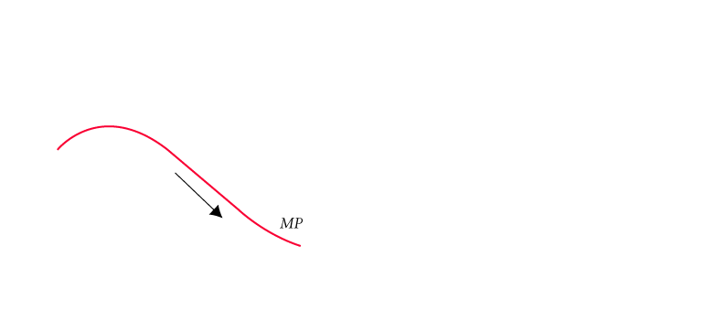
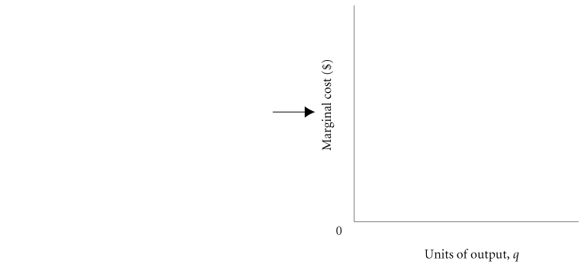
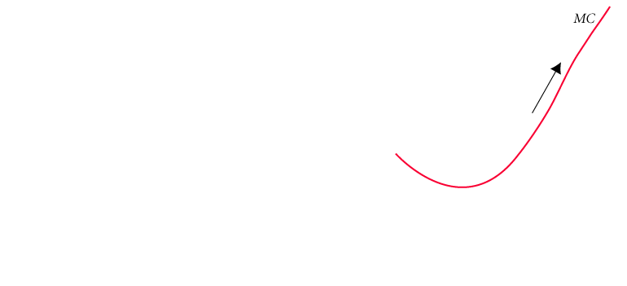
COSTS IN THE SHORT RUN
The Shape of the Marginal Cost Curve in the Short Run
FIGURE 4 Declining Marginal Product Implies That Marginal Cost Will Eventually Rise with Output
<number> of 31

Slide 13
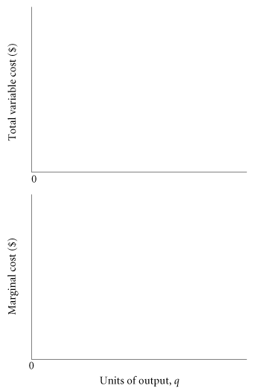
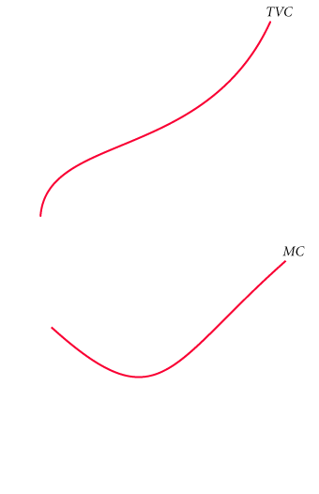
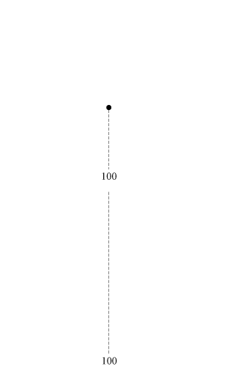
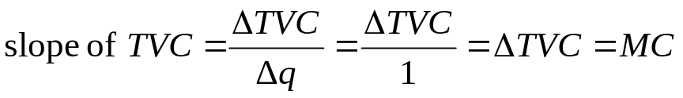
COSTS IN THE SHORT RUN
Graphing Total Variable Costs and Marginal Costs
FIGURE 5 Total Variable Cost and Marginal Cost for a Typical Firm
<number> of 31

Slide 14
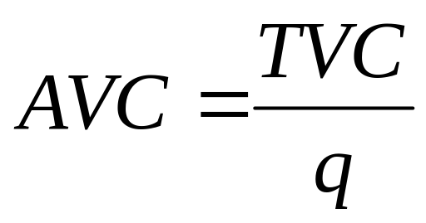
COSTS IN THE SHORT RUN
Average Variable Cost (AVC)
average variable cost (AVC) Total variable cost divided by the number of units of output.
<number> of 31

Slide 15
COSTS IN THE SHORT RUN
TABLE 4 Short-Run Costs of a Hypothetical Firm
(1) q | (2) TVC |  |  | (3) MC (Δ TVC) |  |  | (4) AVC (TVC/q) |  |  | (5) TFC |  |  | (6) TC (TVC + TFC) |  |  | (7) AFC (TFC/q) |  |  | (8) ATC (TC/q or AFC + AVC)
0 | $ | 0 |  | $ | − |  | $ | − |  | $ | 1,000 |  | $ | 1,000 |  | $ | − |  | $ | −
1 |  | 10 |  |  | 10 |  |  | 10 |  |  | 1,000 |  |  | 1,010 |  |  | 1,000 |  |  | 1,010
2 |  | 18 |  |  | 8 |  |  | 9 |  |  | 1,000 |  |  | 1,018 |  |  | 500 |  |  | 509
3 |  | 24 |  |  | 6 |  |  | 8 |  |  | 1,000 |  |  | 1,024 |  |  | 333 |  |  | 341
4 |  | 32 |  |  | 8 |  |  | 8 |  |  | 1,000 |  |  | 1,032 |  |  | 250 |  |  | 258
5 |  | 42 |  |  | 10 |  |  | 8.4 |  |  | 1,000 |  |  | 1,042 |  |  | 200 |  |  | 208.4
− |  | − |  |  | − |  |  | − |  |  | − |  |  | − |  |  | − |  |  | −
− |  | − |  |  | − |  |  | − |  |  | − |  |  | − |  |  | − |  |  | −
− |  | − |  |  | − |  |  | − |  |  | − |  |  | − |  |  | − |  |  | −
500 |  | 8,000 |  |  | 20 |  |  | 16 |  |  | 1,000 |  |  | 9,000 |  |  | 2 |  |  | 18
Marginal cost is the cost of one additional unit. Average variable cost is the total variable
cost divided by the total number of units produced.
<number> of 31

Slide 16
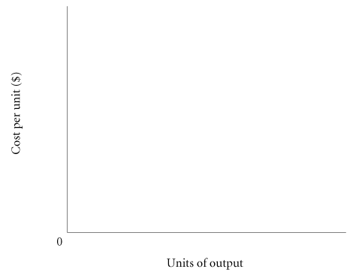
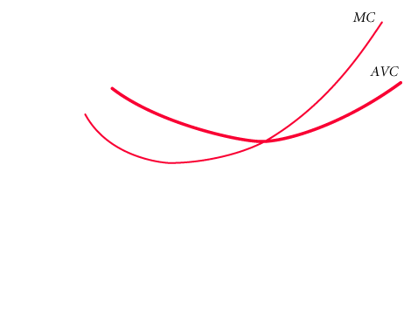
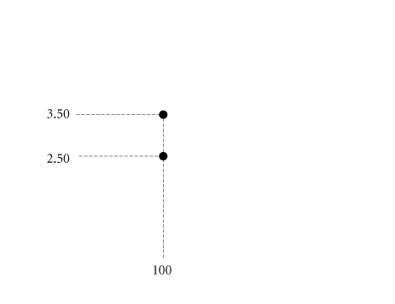
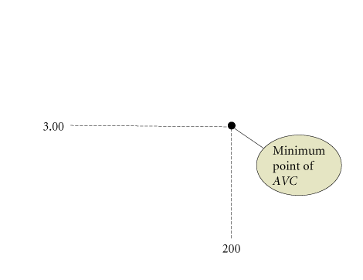
COSTS IN THE SHORT RUN
Graphing Average Variable Costs and Marginal Costs
FIGURE 6 More Short-Run Costs
Marginal cost intersects average variable cost at the lowest, or minimum, point of AVC.
<number> of 31

Slide 17
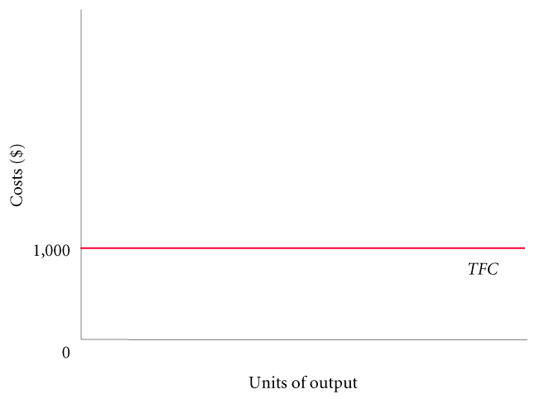
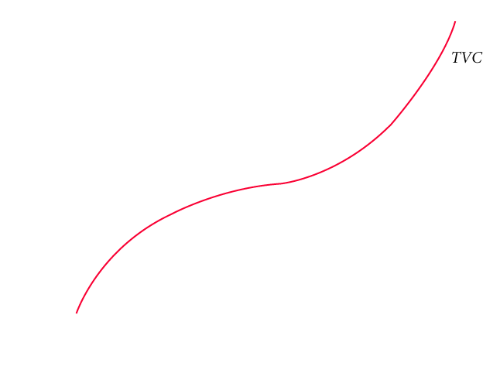
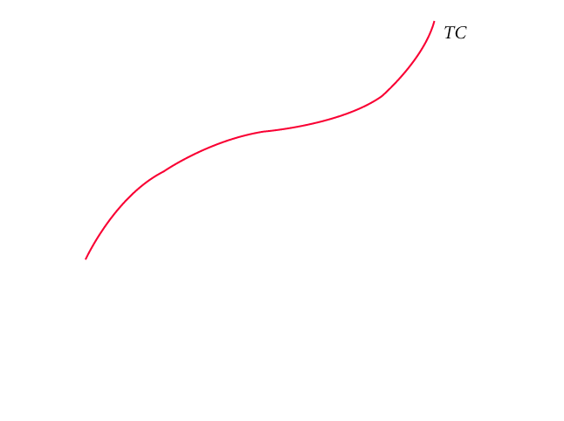
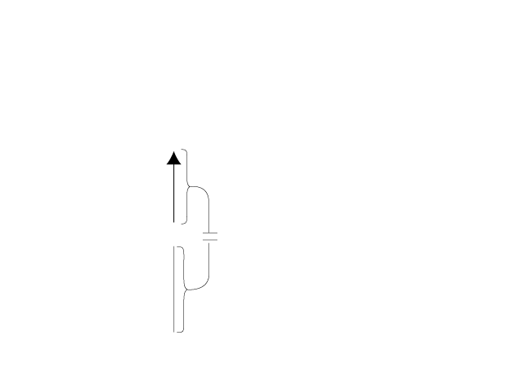
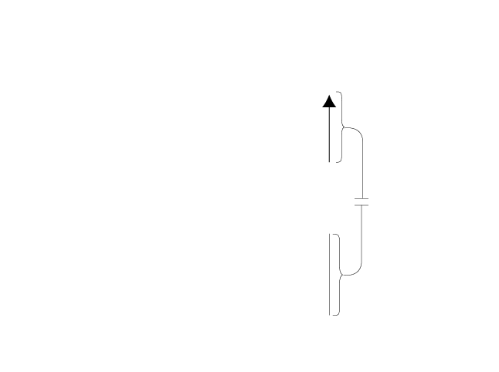
COSTS IN THE SHORT RUN
TOTAL COSTS
FIGURE 8.7 Total Cost = Total Fixed Cost + Total Variable Cost
<number> of 31

Slide 18
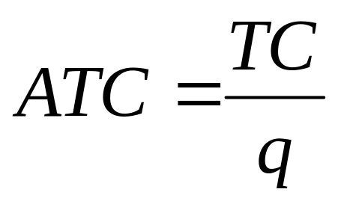
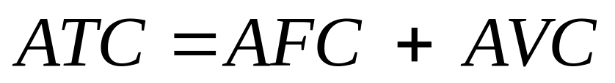
COSTS IN THE SHORT RUN
Average Total Cost (ATC)
average total cost (ATC) Total cost divided by the number of units of output.
<number> of 31

Slide 19
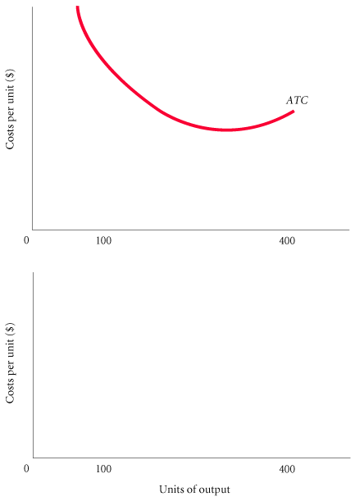
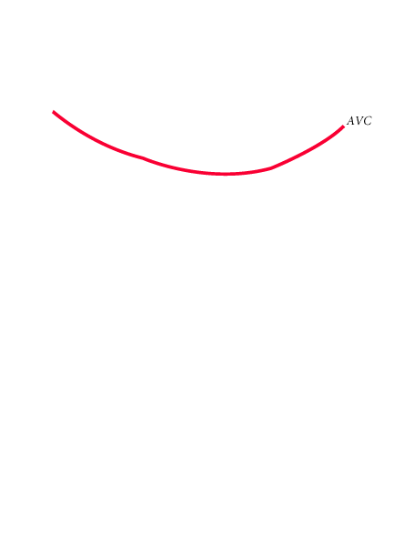
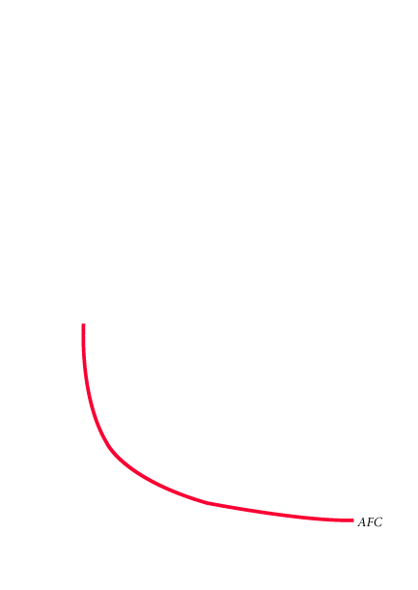
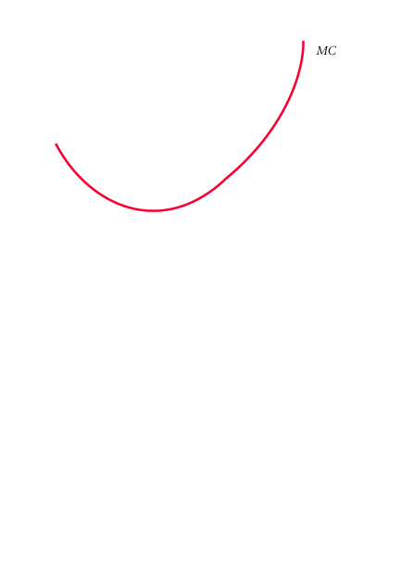
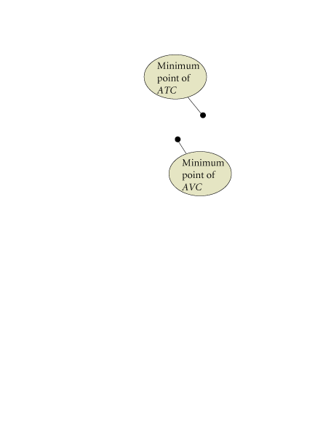
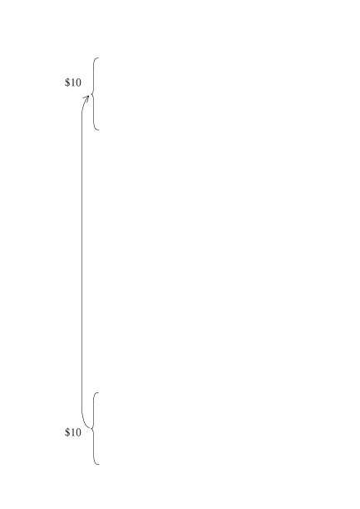
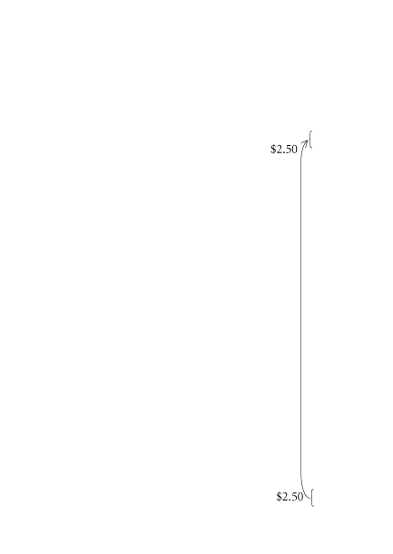
COSTS IN THE SHORT RUN
FIGURE 8 Average Total Cost = Average Variable Cost + Average Fixed Cost
<number> of 31

Slide 20
COSTS IN THE SHORT RUN
The Relationship Between Average Total Cost and Marginal Cost
The relationship between average total cost and marginal cost is exactly the same as the relationship between average variable cost and marginal cost.
If marginal cost is below average total cost, average total cost will decline toward marginal cost. If marginal cost is above average total cost, average total cost will increase. As a result, marginal cost intersects average total cost at ATC’s minimum point, for the same reason that it intersects the average variable cost curve at its minimum point.
<number> of 31

Slide 21
COSTS IN THE SHORT RUN
SHORT-RUN COSTS: A REVIEW
TABLE 5 A Summary of Cost Concepts
TERM | DEFINITION | EQUATION
Accounting costs | Out-of-pocket costs or costs as an accountant would define them. Sometimes referred to as explicit costs. |  | −
Economic costs | Costs that include the full opportunity costs of all inputs. These include what are often called implicit costs. |  | −
Total fixed costs | Costs that do not depend on the quantity of output produced. These must be paid even if output is zero. |  | TFC
Total variable costs | Costs that vary with the level of output. |  | TVC
Total cost | The total economic cost of all the inputs used by a firm in production. | TC = TFC + TVC
Average fixed costs | Fixed costs per unit of output. | AFC = TFC/q
Average variable costs | Variable costs per unit of output. | AVC = TVC/q
Average total costs | Total costs per unit of output. | ATC = TC/q ATC = AFC + AVC
Marginal costs | The increase in total cost that results from producing one additional unit of output. | MC = ΔTC/Δq
<number> of 31

Slide 22
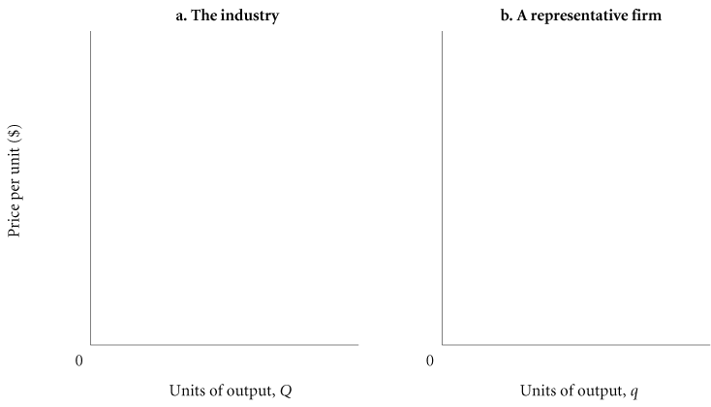
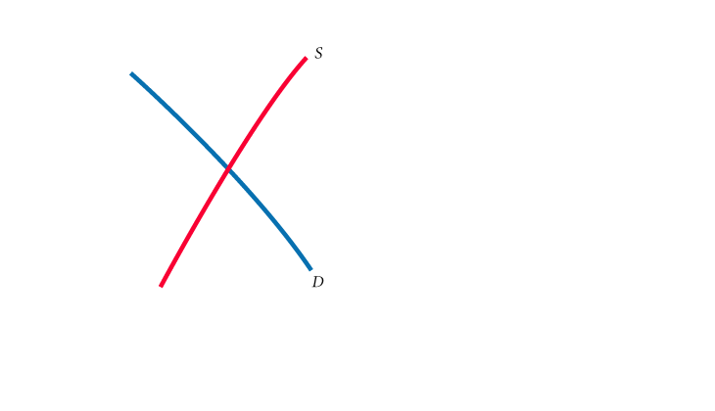
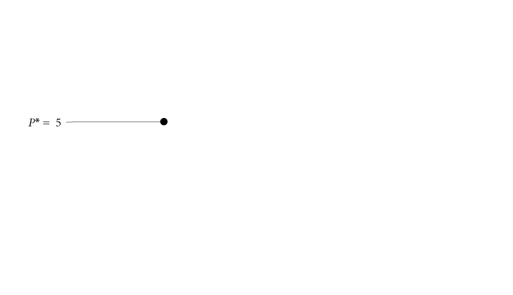
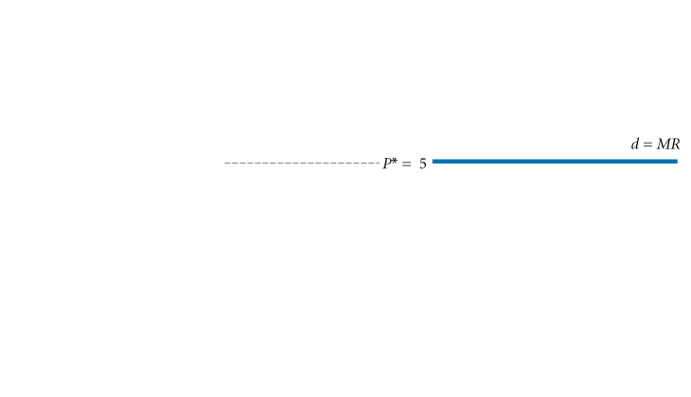
OUTPUT DECISIONS: REVENUES, COSTS,
AND PROFIT MAXIMIZATION
FIGURE 8.9 Demand Facing a Typical Firm in a Perfectly Competitive Market
In the short run, a competitive firm faces a demand curve that is simply a horizontal
line at the market equilibrium price. In other words, competitive firms face perfectly
elastic demand in the short run.
<number> of 31

Slide 23
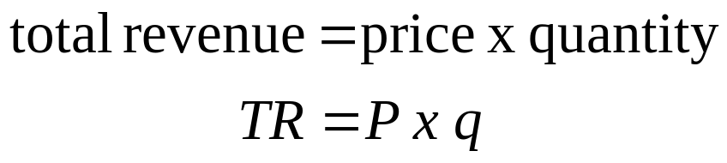
OUTPUT DECISIONS: REVENUES, COSTS,
AND PROFIT MAXIMIZATION
TOTAL REVENUE (TR) AND MARGINAL REVENUE (MR)
total revenue (TR) The total amount that a firm takes in from the sale of its product: the price per unit times the quantity of output the firm decides to produce (P x q).
marginal revenue (MR) The additional revenue that a firm takes in when it increases output by one additional unit. In
perfect competition, P = MR.
<number> of 31

Slide 24
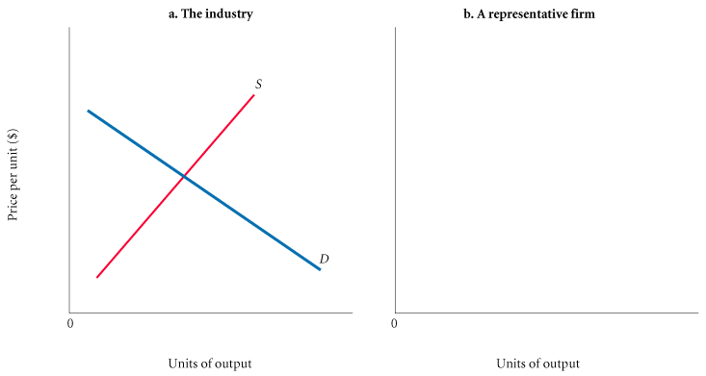
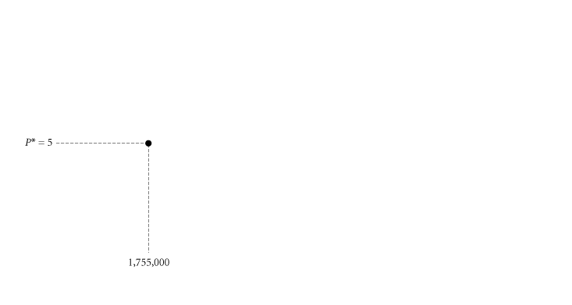
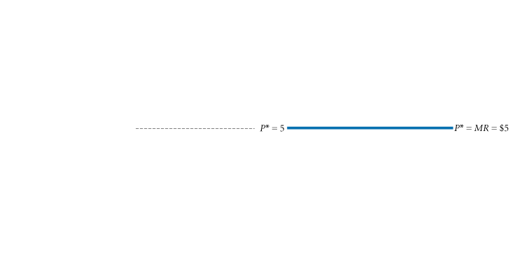
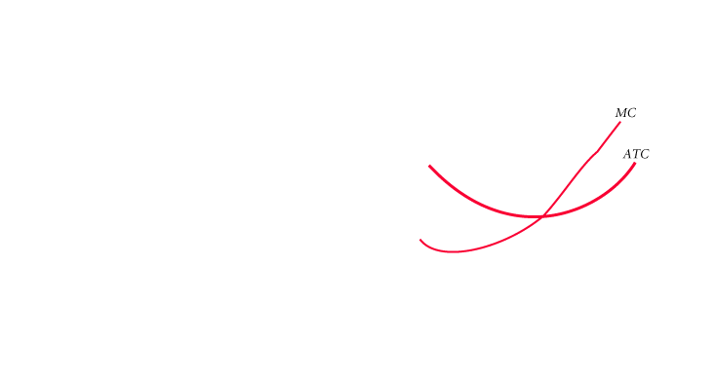
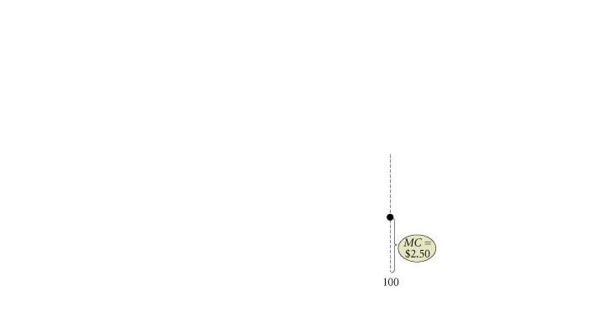



OUTPUT DECISIONS: REVENUES, COSTS,
AND PROFIT MAXIMIZATION
COMPARING COSTS AND REVENUES TO MAXIMIZE PROFIT
The Profit-Maximizing Level of Output
D
A
C
B
FIGURE 8.10 The Profit-Maximizing Level of Output for a Perfectly Competitive Firm
<number> of 31

Slide 25
OUTPUT DECISIONS: REVENUES, COSTS,
AND PROFIT MAXIMIZATION
As long as marginal revenue is greater than marginal cost, even though the difference
between the two is getting smaller, added output means added profit. Whenever marginal
revenue exceeds marginal cost, the revenue gained by increasing output by one unit per period exceeds the cost incurred by doing so.
The profit-maximizing perfectly competitive firm will produce up to the point where
the price of its output is just equal to short-run marginal cost—the level of output at
which P* = MC.
The profit-maximizing output level for all firms is the output level where MR = MC.
<number> of 31

Slide 26
OUTPUT DECISIONS: REVENUES, COSTS,
AND PROFIT MAXIMIZATION
A Numerical Example
TABLE 8.6 Profit Analysis for a Simple Firm
(1) q | (2) TFC |  |  | (3) TVC |  |  | (4) MC |  |  | (5) P = MR |  |  | (6) TR (P x q) |  |  | (7) TC (TFC + TVC) |  |  | (8) PROFIT (TR − TC)
0 | $ | 10 |  | $ | 0 |  | $ | − |  | $ | 15 |  | $ | 0 |  | $ | 10 |  | $ | -10
1 |  | 10 |  |  | 10 |  |  | 10 |  |  | 15 |  |  | 15 |  |  | 20 |  |  | -5
2 |  | 10 |  |  | 15 |  |  | 5 |  |  | 15 |  |  | 30 |  |  | 25 |  |  | 5
3 |  | 10 |  |  | 20 |  |  | 5 |  |  | 15 |  |  | 45 |  |  | 30 |  |  | 15
4 |  | 10 |  |  | 30 |  |  | 10 |  |  | 15 |  |  | 60 |  |  | 40 |  |  | 20
5 |  | 10 |  |  | 50 |  |  | 20 |  |  | 15 |  |  | 75 |  |  | 60 |  |  | 15
6 |  | 10 |  |  | 80 |  |  | 30 |  |  | 15 |  |  | 90 |  |  | 90 |  |  | 0
<number> of 31

Slide 27






OUTPUT DECISIONS: REVENUES, COSTS,
AND PROFIT MAXIMIZATION
THE SHORT-RUN SUPPLY CURVE
FIGURE 8.11 Marginal Cost Is the Supply Curve of a Perfectly Competitive Firm
The marginal cost curve of a competitive firm is the firm’s short-run supply curve.
<number> of 31

